Slide 1
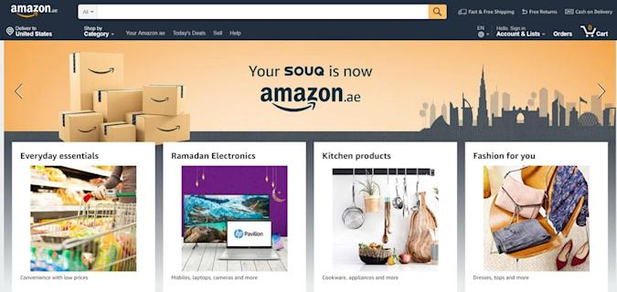

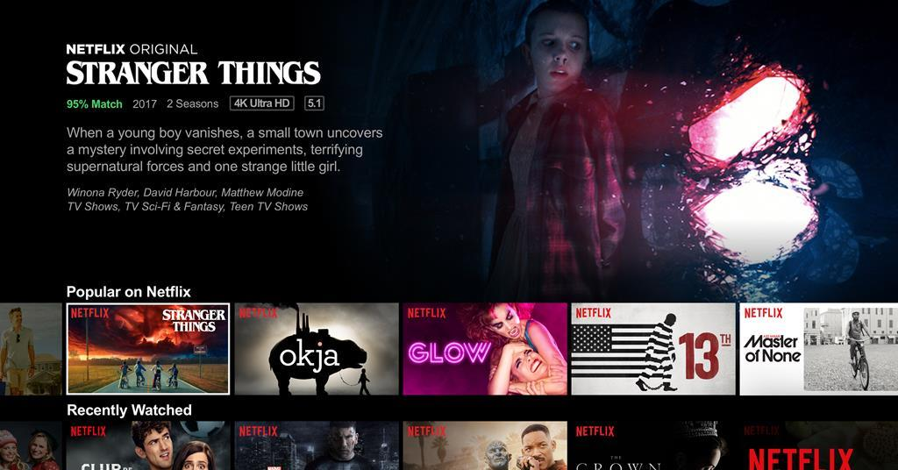
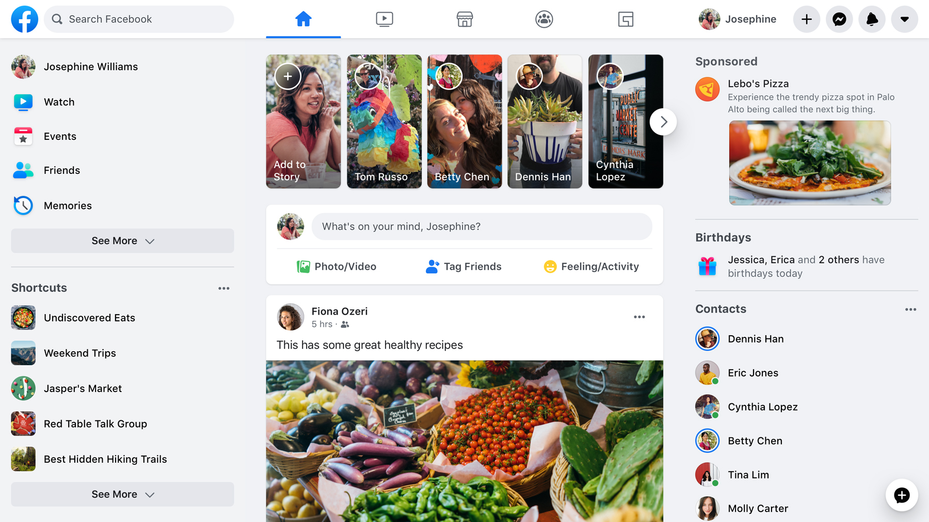
How does the Web work
What is the web
The web :
Constituted from servers that stores information's , host the websites and others
The way of accessing these information's is with the internet
Use protocols to transfer the data

Slide 2
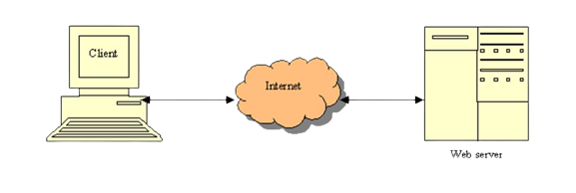
How does the Web work
The Web architecture
- To connect to the server you must have an internet access to transfer the files from the server to the client.
- Clients can be :browsers ,phones ,TV’s or any thing that it can connect with the internet
- The servers are special computers that is designed to provide web pages, data, resources or services.

Slide 3
How does the Web work
Protocols
What is protocol:
Protocols are a set of rules that impose how the devices exchange data between them.
protocols controls all the network communication.
Example of a protocol is http/https or hypertext transfer protocol

Slide 4
What do you need to be a web developer
You need to know the parts of the web:
Front end
Back end
Servers
Api
To be a web developer you need some languages like:
Html
Css
Javascript
Php
python

Slide 5
Why did I choose to learn web development
One of my hobbies is coding and it so I choose the web development as a start of the deviation of my carrier

